Slide 1
AZ-203.2 Module 02: Create Azure App Service Mobile Apps
Subtitle or speaker name
Notes:
In this module, you will cover:
Getting started with Mobile Apps in App Service.
Enabling Push Notifications for your app.
Enabling offline sync for your app.

Slide 2
Topics
Getting started with Mobile Apps in App Service
Enabling Push Notifications for your app
Enabling offline sync for your app
Notes:
These are the topics that will be covered in this module.

Slide 3
Lesson 01: Getting started with Mobile Apps in App Service
Notes:
In this lesson, you will cover:
Mobile Apps
Using the Mobile App backend server in an app

Slide 4

Mobile Apps
Managed mobile application development platform with the same benefits of Azure App Service Web Apps
Additional mobile-centric server-side features
Support for identity providers, including Azure Active Directory for enterprise authentication, and social providers such as Facebook, Google, Twitter, and Microsoft accounts
Mobile-friendly OData v3 data source that's linked to Azure SQL Database or an on-premises SQL server
Notes:
Azure App Service is a fully managed platform as a service (PaaS) offering for professional developers. The service brings a rich set of capabilities to web, mobile, and integration scenarios.
With the Mobile Apps feature, you can:
Build native and cross-platform apps: Whether you're building native iOS, Android, and Windows apps or cross-platform Xamarin or Cordova (PhoneGap) apps, you can take advantage of App Service by using native SDKs.
Connect to your enterprise systems: With the Mobile Apps feature, you can add corporate sign-in in minutes, and connect to your enterprise on-premises or cloud resources.
Build offline-ready apps with data sync: Make your mobile workforce more productive by building apps that work offline, and use Mobile Apps to sync data in the background when connectivity is present with any of your enterprise data sources or software as a service (SaaS) APIs.
Push notifications to millions in seconds: Engage your customers with instant push notifications on any device, personalized to their needs, and sent when the time is right.

Slide 5






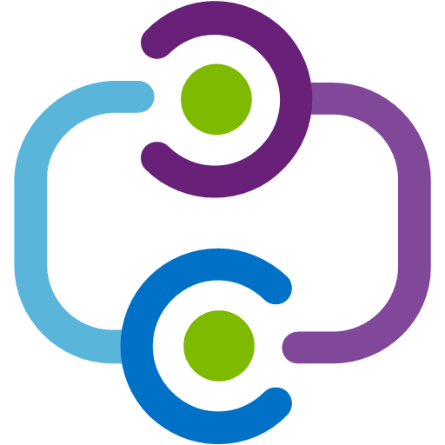








Mobile Apps platform
Native SDKs
Windows
iOS
Android
Offline Sync
Data
Office 365
Salesforce
Dynamics
SQL
Tables
Mongo DB
On-premises
User Authentication
Node.js Express
.NET
Web API
User authentication
REST API
X-Plat SDKs
HTML5/JS
Xamarin
Phonegap
Sencha
Facebook
Twitter
Microsoft
Google
Azure Active Directory
Azure Active Directory
Push Notifications
iOS
OSX
Android
Chrome
Windows
Kindle
In-app
Notes:
The Mobile Apps feature of Azure App Service gives enterprise developers and system integrators a mobile-application development platform that's highly scalable and globally available.
The following features are important to cloud-enabled mobile development:
Authentication and authorization: Support for identity providers, including Azure Active Directory for enterprise authentication, plus social providers such as Facebook, Google, Twitter, and Microsoft accounts. Mobile Apps offers an OAuth 2.0 service for each provider. You can also integrate the SDK for the identity provider for provider-specific functionality.
Data access: Mobile Apps provides a mobile-friendly OData v3 data source that's linked to Azure SQL Database or an on-premises SQL Server. Because this service can be based on Entity Framework, you can easily integrate with other NoSQL and SQL data providers, including Azure Table storage, MongoDB, Azure Cosmos DB, and SaaS API providers such as Office 365 and Salesforce.com.
Offline sync: The client SDKs make it easy to build robust and responsive mobile applications that operate with an offline dataset. You can sync this dataset automatically with the back-end data, including conflict-resolution support.
Push notifications: The client SDKs integrate seamlessly with the registration capabilities of Azure Notification Hubs, so you can send push notifications to millions of users simultaneously.
Client SDKs: There is a complete set of client SDKs that cover native development (iOS, Android, and Windows), cross-platform development (Xamarin.iOS and Xamarin.Android, Xamarin.Forms), and hybrid application development (Apache Cordova). Each client SDK is available with an MIT license and is open-source.

Slide 6
Mobile Apps client SDKs
Provide native development support for multiple platforms
iOS, Android, and Windows; Xamarin.iOS, Xamarin.Android, Xamarin.Forms, and Apache Cordova
Sync data automatically for occasionally-connected scenarios
Integrate with Notification Hubs
Hybrid SDKs
Apache
Cordova
Native SDKs
Windows
iOS
Android
Cross-Platform SDKs
Xamarin.iOS
Xamarin.Android
Xamarin.Forms
Notes:
The Azure Mobile Apps application development platform offers a set of client SDKs that provide the following types of application development support:
Native development: This includes client SDKs that cover native development (iOS, Android, and Windows).
Cross-platform development: This includes client SDKs that cover Xamarin.iOS, Xamarin.Android, and Xamarin.Forms.
Hybrid development: This includes open source development frameworks like Apache Cordova.
Each client SDK is available with a Massachusetts Institute of Technology (MIT) SA:SS license and is open-source.
Each SDK includes offline dataset functionality that syncs automatically and handles conflict resolution.
The SDKs also integrate seamlessly with the registration capabilities of Azure Notification Hubs, so you can send push notifications to client devices.

Slide 7









Mobile Apps ecosystem
REST API
Your Code/Scripts
Node.js
.NET
Auth
Data
Push
Other
Notes:
Mobile Apps provides the capability to add a mobile-optimized data access Web API to a web application. The Mobile Apps SDK is provided for ASP.NET and Node.js web applications.
The SDK provides the following operations:
Table operations (read, insert, update, and delete) for data access.
Push notifications
Authentication support with popular identity providers (Facebook, Twitter, Google, and Microsoft Azure Active Directory).
Custom API operations
The Azure Mobile Apps service is a middleware tier that hosts your code in a special back-end service and provides client SDKs that can communicate with your back-end code.

Slide 8
Authentication
Client flow
SDK from identity provider
Server doesn’t have access to token
Client can use token to consume provider APIs
Login experience is familiar to users who natively use the identity provider's applications
Server flow
Built-in web control to authenticate user
Server must manage token and sign-in process
Preferred
method
Notes:
There are two approaches to authentication with Azure Mobile Apps:
Use an SDK that a given identity provider publishes to establish identity, and then gain access to App Service.
Use a single line of code so that the Mobile Apps client SDK can sign in users.
When you use a provider software development kit (SDK), users can sign in to an experience that integrates more tightly with the operating system that the app is running on. This method also gives you a provider token and some user information on the client, which makes it much easier to consume graph APIs and customize the user experience. Occasionally on blogs and forums, this is referred to as the client flow or client-directed flow because the client code signs in users and has access to a provider token.
If you do not want to set up a provider SDK, you can allow the Mobile Apps feature of Azure App Service to sign in for you. The Mobile Apps client SDK opens a web view to the provider of your choice and signs in the user. Occasionally on blogs and forums, it’s called the server flow or server-directed flow because the server manages the process that signs in the users, and the client SDK never receives the provider token.

Slide 9


Authentication with Azure Active Directory
Mobile App
Azure SQL DB
App Service
2
Azure Storage
1
Azure Active Directory
Notes:
You can use the Active Directory Authentication Library (ADAL) to sign users into your application by using Azure Active Directory. This functionality is provided through the ADAL plug-in, which can be used both with Azure AD and on-premises Active Directory Federation Services (AD FS) version 3 and newer. The plug-in uses the Android, iOS, and .NET ADAL native libraries under the hood and therefore persists authentication tokens in a secure cache that you can then query to pass to downstream services.
By using the ADAL, you can perform manual authentication against Azure AD and then use the persisted authentication token to communicate to your Mobile App. All the services related to your Mobile App (Azure Storage and SQL DB) are automatically authenticated by App Service.
At this time, Azure AD version 2 (including MSAL) is not supported for Azure App Services and Azure Functions.

Slide 10
Demo: Using the Mobile App back-end server in an app
Notes:
This revision of the course does not ship with demo instructions. For each demo, you will be given a list of specific tasks you should demonstrate to your students. The flow, content and structure of your demo is left to you to decide as an instructor.
In this demo, you should show students how to:
Create a new Azure mobile app backend.
Configure a .NET server project and connect to a database.
Deploy and run a sample app.

Slide 11
Lesson 02: Enabling push notifications for your app
Notes:
In this lesson, you will cover:
Push notifications.
Configure a Notification Hub.
Register your app for push notifications.
Configure the backend to send push notifications.
Update the server to send push notifications.
Add push notifications to your app.

Slide 12
Push notifications
Each mobile device company delivers notifications through Platform Notification Systems (PNSes)
Infrastructure and usage is platform specific
No common interface between companies
Typically, sending push notifications requires writing code three times:
Apple - Apple Push Notification System (APNS)
Google - Firebase Cloud Messaging (FCM)
Microsoft - Windows Notification Service (WNS)
Notes:
Push notifications are delivered through platform-specific infrastructures called Platform Notification Systems (PNSes). They offer basic push functionalities to deliver a message to a device with a provided handle, and have no common interface.
To send a notification to all customers across the iOS, Android, and Windows versions of an app, the developer must work with Apple Push Notification Service (APNS), Firebase Cloud Messaging (FCM), and Windows Notification Service (WNS).

Slide 13


Push notifications (continued)
2. Store PNS handle
1. Retrieve PNS handle
4. Send to device
Mobile Apps
3. Send notification
Platform Notification Service
Notes:
At a high level, here is how push works:
The client app decides it wants to receive notifications. Hence, it contacts the corresponding Platform Notification Service (PNS) to retrieve its unique and temporary push handle. The handle type depends on the system (for example, Windows Push Notification Services (WNS) has Uniform Resource Identifiers (URIs) while Apple Platform Notification Services (APNS) has tokens.
The client app stores this handle in the app backend or provider.
To send a push notification, the app backend contacts the PNS by using the handle to target a specific client app.
The PNS forwards the notification to the device specified by the handle.

Slide 14
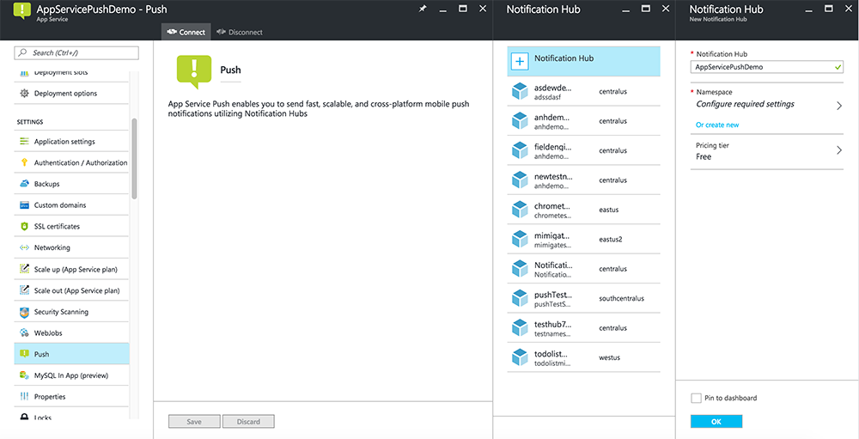
Configure a Notification Hub
Notes:
The Mobile Apps feature of Azure App Service uses Azure Notification Hubs to send pushes, so you will be configuring a notification hub for your mobile app.

Slide 15
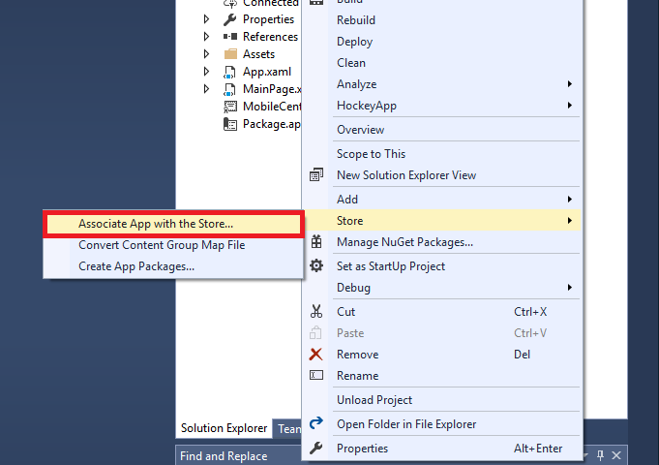
Register your app for push notifications
Notes:
You need to submit your app to the Microsoft Store, then configure your server project to integrate with Windows Notification Services (WNS) to send push.

Slide 16
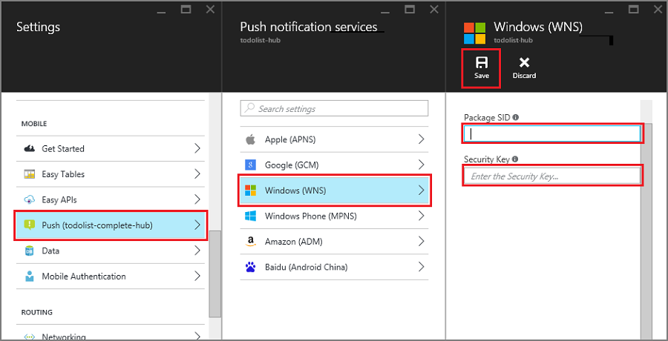
Configure the backend to send push notifications
Notes:
You can use the portal to configure the backend of your application to send push notifications.

Slide 17
Update the server to send push notifications
HttpConfiguration config = this.Configuration;
MobileAppSettingsDictionary settings =
this.Configuration.GetMobileAppSettingsProvider().GetMobileAppSettings();
NotificationHubClient hub = NotificationHubClient
.CreateClientFromConnectionString(notificationHubConnection, notificationHubName);
var windowsToastPayload = @"<toast><visual><binding template=""ToastText01""><text id=""1"">" + item.Text + @"</text></binding></visual></toast>";
await hub.SendWindowsNativeNotificationAsync(windowsToastPayload);
Notes:
This code tells the notification hub to send a push notification by using the WNS format.

Slide 18
Add push notifications to your app
private async Task InitNotificationsAsync()
{
// Get a channel URI from WNS.
var channel = await PushNotificationChannelManager
.CreatePushNotificationChannelForApplicationAsync();
// Register the channel URI with Notification Hubs.
await App.MobileService.GetPush().RegisterAsync(channel.Uri);
}
protected async override void OnLaunched(LaunchActivatedEventArgs e)
{
await InitNotificationsAsync();
}
Notes:
Next, your app must register for push notifications on startup. When you have already enabled authentication, make sure that the user signs-in before trying to register for push notifications.

Slide 19
Demo: Configure and use a Notification Hub
Notes:
The Mobile Apps feature of Azure App Service uses Azure Notification Hubs to send pushes, so you will be configuring a notification hub for your mobile app.
This revision of the course does not ship with demo instructions. For each demo, you will be given a list of specific tasks you should demonstrate to your students. The flow, content and structure of your demo is left to you to decide as an instructor.
In this demo, you should show students how to:
Configure a Notification Hub.
Register an app for push notifications.
Configure an application backend to send push notifications.
Add push notifications to the app.

Slide 20
Lesson 03: Enabling offline sync for your app
Notes:
In this lesson, you will cover:
Offline Sync.
Updating the client app to support offline features.
Update the app to disconnect from the backend.
Update the app to reconnect to the backend.

Slide 21
Offline sync
Offline sync allows end users to interact with a mobile app—viewing, adding, or modifying data —even when there is no network connection
When the device is offline, changes are temporarily stored in a local database
After the device is back online, these changes are synced with the remote backend
Notes:
Offline sync allows end users to interact with a mobile app—viewing, adding, or modifying data—even when there is no network connection. Changes are stored in a local database. After the device is back online, these changes are synced with the remote backend.

Slide 22
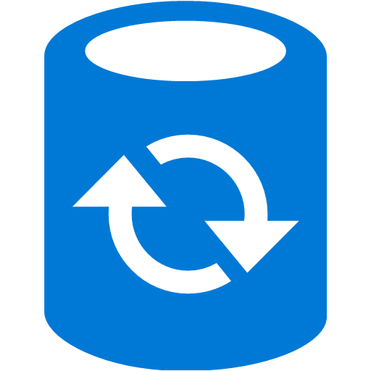
Offline sync (continued)
Azure SQL DB
Mobile App
Tablet
Offline Sync
Azure Storage
Table Storage
Notes:
When your app is in the offline mode, you can still create and modify data that is saved to a local store (illustrated in this diagram as "offline sync"). This local store is typically a database.
When the app is back online, it can synchronize changes in your local storage with your Azure Mobile App backend. The feature also includes support for detecting conflicts when the same record is changed for both the client and the backend. This enables the server or the client to handle conflicts.

Slide 23
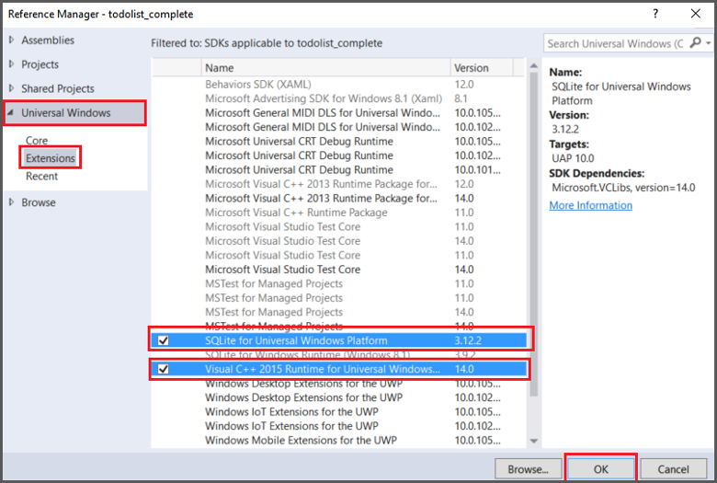
Updating the client app to support offline features
Universal Windows References
SQLite for Universal Windows Platform
Visual C++ 2015 Runtime for Universal Windows Platform apps
NuGet Packages
Microsoft.Azure.Mobile.Client.SQLiteStore
Notes:
Azure Mobile App offline features allow you to interact with a local database when you are in an offline scenario. To use these features in your app, you initialize a SyncContext to a local store. Then reference your table through the IMobileServiceSyncTable interface. SQLite is used as the local store on the device.

Slide 24
Demo: Configuring offline sync in a mobile app
Notes:
The offline sync feature of Mobile Apps allows end users to interact with a mobile app—viewing, adding, or modifying data—even when there is no network connection.
This revision of the course does not ship with demo instructions. For each demo, you will be given a list of specific tasks you should demonstrate to your students. The flow, content and structure of your demo is left to you to decide as an instructor.
In this demo, you should show students how to:
Updating a client app to support offline features.
Update the app to disconnect from the backend.
Update the app to reconnect to the backend.

Slide 25
API summary
There are multiple methods to synchronize the local store with the server:
PushAsync
Changes across all local tables are pushed to the backend
PullAsync
When there are changes to the backend tables, the delta is pulled to local tables
PurgeAsync
Stale local data is removed and any changes are pushed to the backend
Notes:
To support the offline features of mobile services, we used the IMobileServiceSyncTable interface and initialized MobileServiceClient.SyncContext with a local SQLite database. When offline, the normal CRUD operations for Mobile Apps work as if the app is still connected while the operations occur against the local store. The following methods are used to synchronize the local store with the server:
PushAsync
Because this method is a member of IMobileServicesSyncContext, changes across all tables are pushed to the backend. Only records with local changes are sent to the server.
PullAsync
A pull is started from a IMobileServiceSyncTable. When there are tracked changes in the table, an implicit push is run to make sure that all tables in the local store along with relationships remain consistent. The pushOtherTables parameter controls whether other tables in the context are pushed in an implicit push. The query parameter takes an IMobileServiceTableQuery or OData query string to filter the returned data. The queryId parameter is used to define incremental sync.
PurgeAsync
Your app should periodically call this method to purge stale data from the local store. Use the force parameter when you need to purge any changes that have not yet been synced.

Slide 26
Review
Getting started with Mobile Apps in App Service
Enabling push notifications for your app
Enabling offline sync for your app
Notes:
These are the topics that we discussed in this module.

